Slide 1
Intro to Angular 2
Spencer Schneidenbach

Slide 2
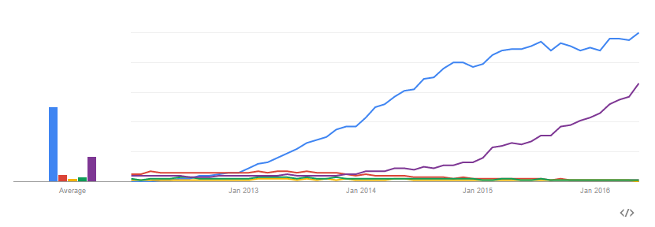

History lesson
Angular 1 – started in 2009
Hugely popular – won the initial “SPA war”

Slide 3
Angular 2
Announced in 2014
Shook the boat quite a bit
Lots of big changes
Lots of initial pushback

Slide 4
Angular 1 to 2 - What’s changed?
Controllers to components
Digest loop to unidirectional data flow
Two-way data binding to… unidirectional data flow
Native event/property binding
Way fewer custom directives
Binding directly to DOM properties/events
Simplified service model
Easier to understand. Flatter learning curve.

Slide 5
Angular 1 to 2 – What stayed the same?
Template syntax is very similar
One-way data binding via interpolation {{ }}
Dependency injection is still used
Directives and components
Overall, feels very familiar

Slide 6
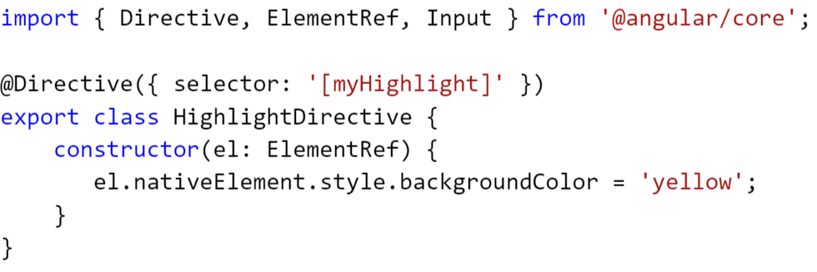
Directives
Used to modify behavior of DOM elements
There are also structural directives and attribute directives
Here is an attribute directive (from angular.io)
Structural directives (prefixed with *) can add/remove DOM elements

Slide 7
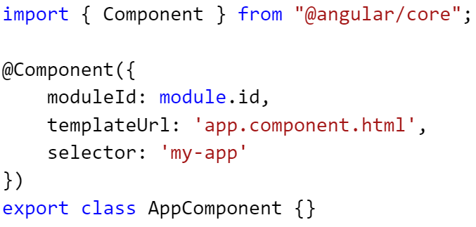
Components
Notes:
Components are directives with a template
Angular 2 apps are built with components
In TypeScript, they’re just classes with the Component decorator
No more $scope, no more controller
Component scope is much easier to understand
No more transclusion, isolate scope, etc.
Functions/properties are bound directly from component
Encapsulated
Example: styling applied directly to component isn’t exposed out
Go over how to declare it (import, class, decorate)

Slide 8
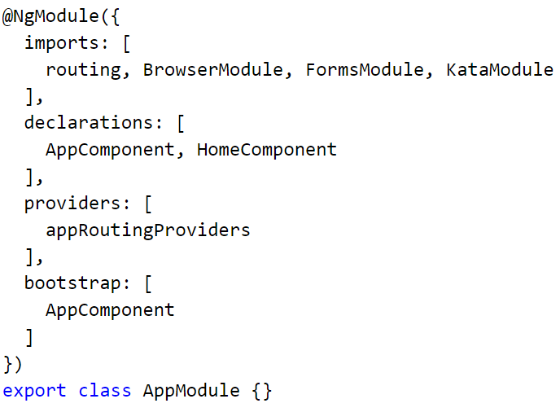
Modules
Notes:
Angular 2’s organizational unit
Contains services, directives, pipes and

Slide 9
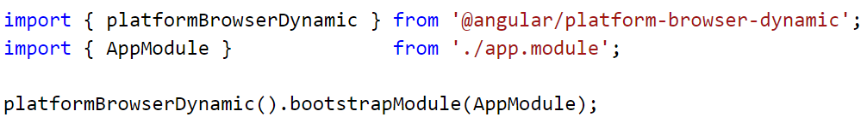
Running your app
Import your root NgModule
Bootstrap it!

Slide 10
Steps to setting up your app
Write your module
Write your component
Write “main” method
Import the proper scripts
Choose your module loader
Run your app!

